Slide 1

Lead &
Opportunity
Scoring
Group 28:
Xin Li, Xinhui LU, Ziyan Zhao, Bing Yuan, Raelene Huang

Slide 2


Meet the team
Bing Lesley Yuan , Xin Li , Xinhui Lu , Ziyan Zhao , Raelene Huang
350274,1029029,965246, 1020405, 694488
Limited Resources!

Slide 3
Client
University of Melbourne’s constituents' team
Research
Focuses on industry partners
Offers research collaboration, consultancy and innovation collaboration.
Scope of the Project
Develop a scoring model for the opportunities
Gain insights / determine the
Limited Resources!

Slide 4


Problem Statements
01
Generate a lead scoring model
Scoring each lead/opportunity in terms of its likelihood of success of conversion into a financial agreement and relationships.
02
What are the key drivers for successful conversion?

Slide 5
Key Challenges
Dealing with missing data
Data entry issues (data cleaning)
Feature engineering (categorial data)
Imbalanced dataset
Model selection
Model tuning
Validating performance
Interpreting models and results

Slide 6
ML Pipeline
• Which stage/stages of the data science pipeline does your project focus on?
Visualising the pipeline and highlighting our sections.

Slide 7



Data
X EDUCATION
Offers online courses
Raw Dataset: 9074 historical leads
Converted Rate: 37.8%
The attributes are similar to our client’s dataset !!

Slide 8
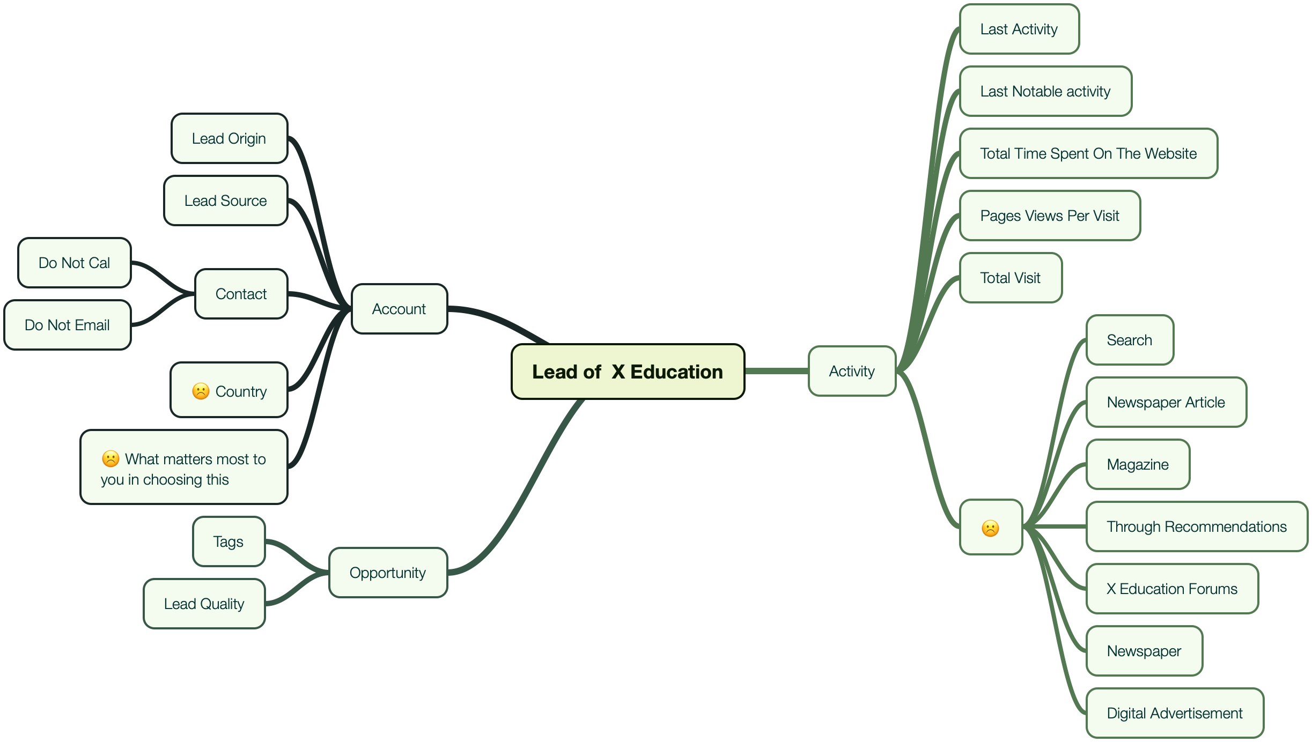


Slide 9
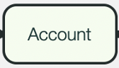
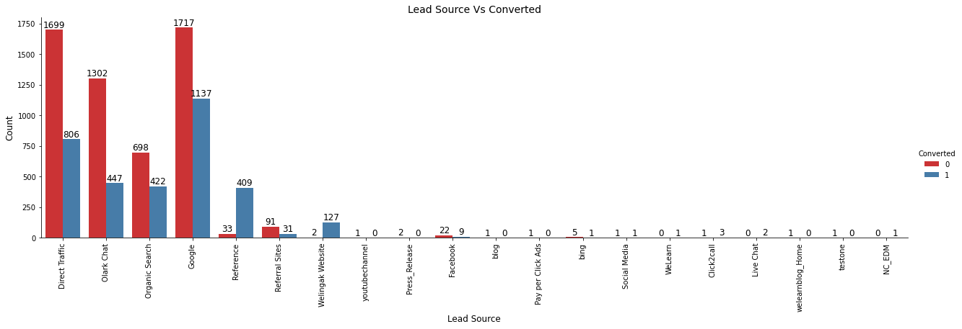
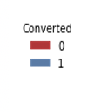
not converted
converted

Slide 10
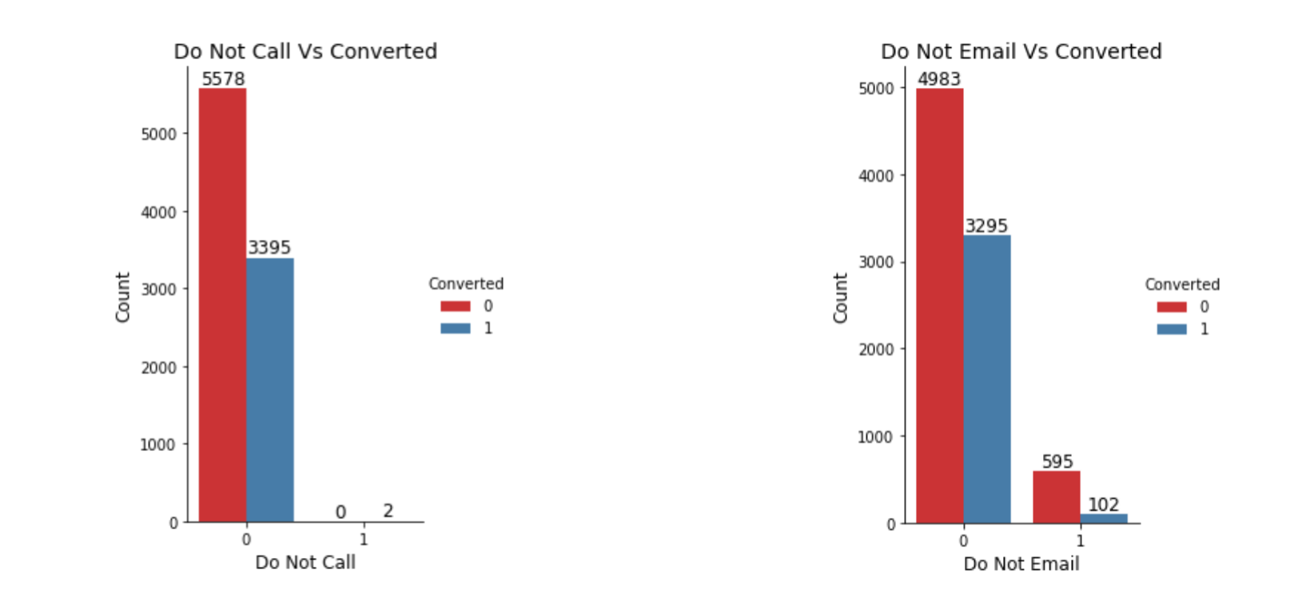
not converted
converted
not converted
converted
Call
Not Call
Email
Not email

Slide 11

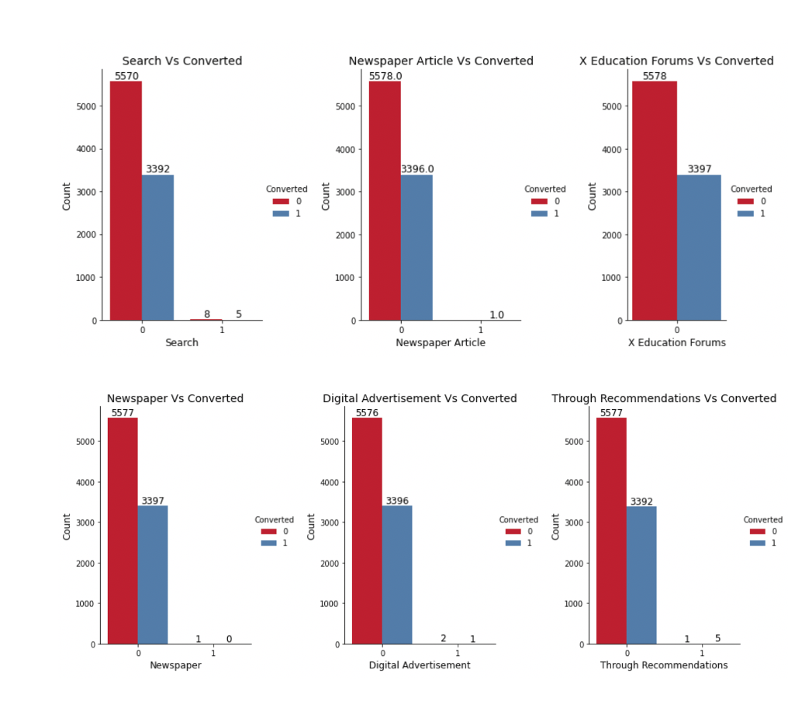
not converted
converted
not converted
converted
not converted
converted
not converted
converted
not converted
converted
not converted
converted
not converted
converted

Slide 12
Features Removed!

Slide 14
Related Literature & Techniques
Brief review of related literature / techniques used

Slide 15
Dealing with Missing Data
Features | # rows with missing data | Percentage of missing data
Lead Source | 36 | 0.4%
TotalVisits | 137 | 1.5%
Page Views Per Visit | 137 | 1.5%
Last Activity | 103 | 1.1%
Specialization | 1438 | 15.6%
How did you hear about X Education | 2207 | 23.9%
What is your current occupation | 2690 | 29.1%
What matters most to you | 2709 | 29.3%
Tags | 3353 | 36.3%
Lead Quality | 4767 | 51.6%
Lead Profile | 2709 | 29.3%
City | 1420 | 15.4%
Asymmetrique Activity Index | 4218 | 45.6%
Asymmetrique Profile Index | 4218 | 45.6%
Asymmetrique Activity Score | 4218 | 45.6%
Asymmetrique Profile Score | 4218 | 45.6%

Slide 16
Dealing with Missing Data
Means Imputation
K-Means
Fitting Missing Value
Advantage
Simple to implement
Disadvantage
not accurate enough
may introduce noise or change the original distribution of the feature
The accuracy of imputation depends on clustering results,
The variability of the clustering results is very large
Regression prediction
Maximum likelihood
Random forest

Slide 17
Dealing with Missing Data
Approach | Logistic Regression (Baseline)
 | Precision | Recall | F1socre
K-Means | 0.7229 | 0.7865 | 0.7533
Random Forest | 0.7201 | 0.78 | 0.7489
No Imputation | 0.5528 | 0.7367 | 0.6366

Slide 18
Feature | Estimate | P-value | Significant Level
Total Time Spent on Website | 21.147 | < 2e-16 | ***
Tags - Closed by Horizzon | 8.896 | < 2e-16 | ***
Tags - Lost to EINS | 11.145 | < 2e-16 | ***
Lead Quality - Not sure | -3.758 | < 2e-16 | ***
Tags - Busy | 6.027 | 1.67E-09 | ***
Total Visits | 4.437 | 9.11E-06 | ***
Do Not Email | -4.207 | 2.59E-05 | ***
Lead Quality - Worst | -4.084 | 4.88E-05 | ***
Lead Origin - Landing Page Submission | -4.015 | 5.95E-05 | ***
Lead Quality - Might be | -3.464 | 0.000532 | ***
Tags - Hangup | 2.744 | 0.006078 | **

Slide 19
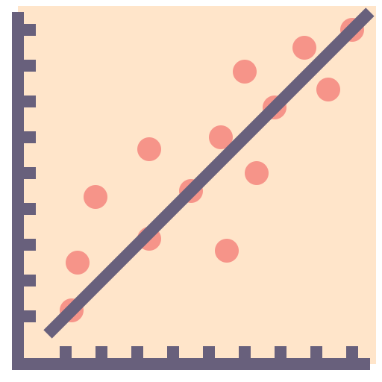
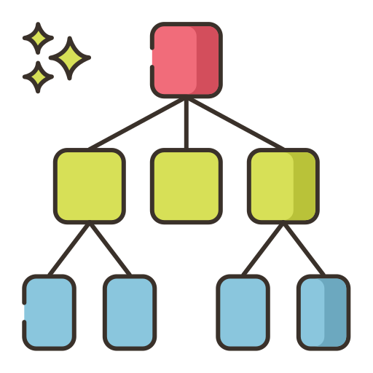

Public Data
01
Create “Train” and “Test” data sets
Randomly split into 66% and 34% for the “Train” and “Test” data sets respectively
Train (66%)
Test (34%)
Non-linear Classifier
Works with Missing Values
02
 | Logistic Regression | Decision Tree
MSE | 0.1197 | 0.1274
Precision | 0.925 | 0.915
Recall | 0.925 | 0.915
F-Measure | 0.925 | 0.914
TP Rate | 0.925 | 0.915
FP Rate | 0.090 | 0.110
AUC | 0.972 | 0.931
Logistic Regression Model
Method
Examine the Significance of the Features
03
Decision Tree
Tree-like Graph
Present decisions and their possible consequences
04
Evaluation
Logistic Regression Model performs better
Lower MSE
Higher precision, recall, F-measure, AUC

Slide 20
Method
01
Logistic Regression

Slide 21
Logistic Regression
01
Why LR first?
High interpretability
Can efficiently describe the relationship between a dependent binary class
Examine the Significance of the Features
Give a baseline metric for our latter models
Evaluation metrics
02
Accuracy | Precision | Recall | F1 score
0.6727 | 0.5535 | 0.5625 | 0.5580
Feature importance
03
19 variables and around 300 features
Only whose p-value < 0.05 are considered as significant features

Slide 22
Method
01
Logistic Regression
02

Slide 23
Method
01
Logistic Regression
02
03
Neural Network

Slide 24
Business Insights
The contacts within the relevant industry as the project are easier to be engaged
01
There is no significant correlation between the specialisation or occupation and the success rate of the sales leads within the sample dataset.
The contacts have had interactions with university before are more likely to be engaged
02
The total time spent on website and total visits were found to be the most significant features indicates that more time the clients spent on getting to know you will increase the success rate.
The success rate is related to The size of the project/benefits
03
There is no data to test this hypothesis yet.
Furthermore, the leads with several tags such as hang up, busy, switched and closed were also found to be significant.

Slide 25



Conclusion
Exploratory data analysis
Dealing with missing data
Lead scoring models
Privacy Impact Assessment
What’s next
Complete PIA for datasets
Fit model with real data
Identify key drivers
Client profiling and effective engagement strategy*

Slide 26
THANK YOU!
Group 28:
Xin Li | Xinhui Lu | Ziyan Zhao | Bing Yuan | Raelene Huang

